Slide 1
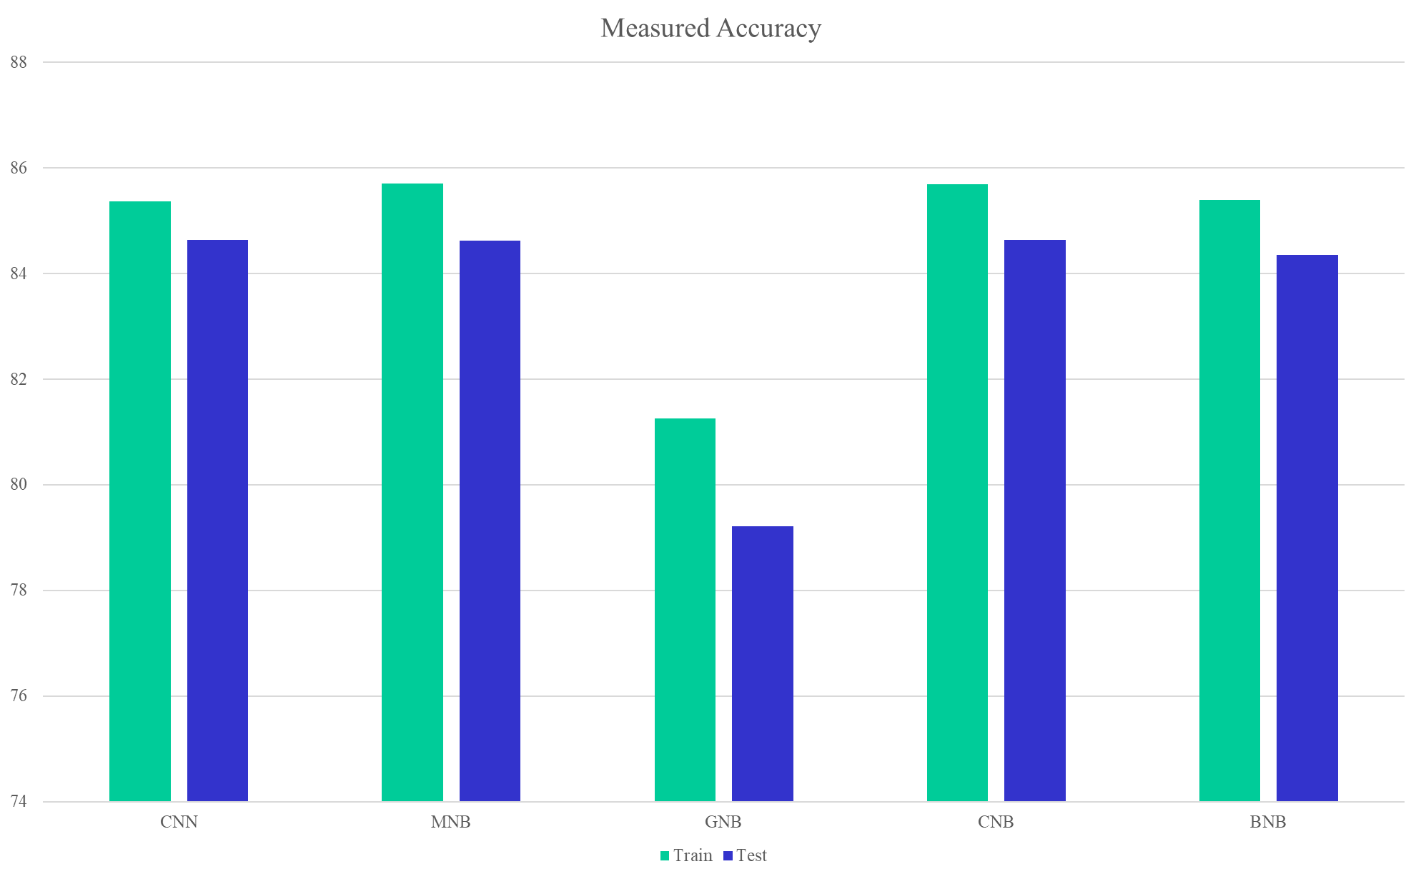
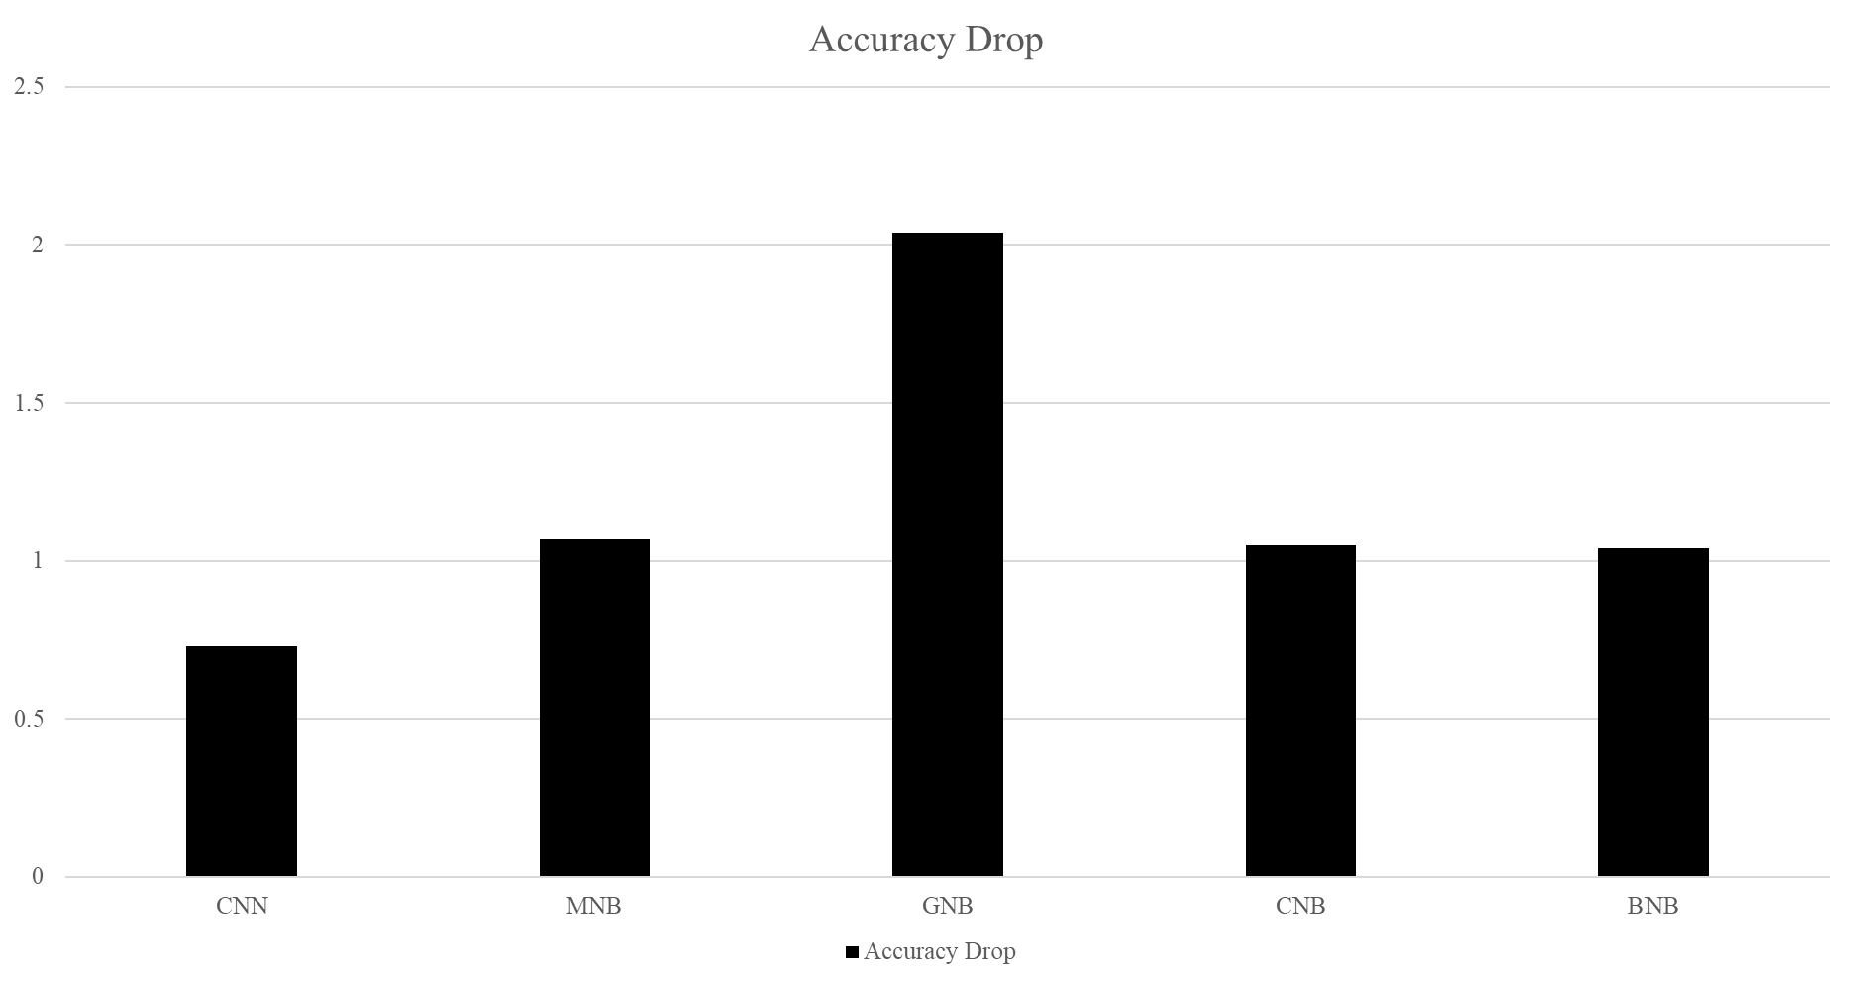



Natural Langauage Processing: Sentiment Analysis
Johnathen Flores, Christopher Aguilar, Alex Kind, Zachary Ross, Edgar Vasquez, Dr. Kevin Desai, PhD The University of Texas at San Antonio, San Antonio, TX 78249
ABSTRACT
METHODOLOGY
As a group we decided to study sentiment analysis a technique in natural language processing. The goal of this study is to find out what machine learning methods are used to do sentiment analysis and how accurate they can be. Our hypothesis is that there are multiple machine learning methods which vary in accuracy. We used the programming language Python and multiple libraries to test five different machine learning methods. Each five methods produced different accuracies relatively close to 85%. However, Gaussian Naive Bayes was slightly below 80%. Meaning most methods were about the same in performance except Gaussian Naive Bayes
We used the programming language Python and imported multiple libraires to load the IMDB data set and to implement multiple machine learning methods.
Python libraires used:
1. TensorFlow
2. Scikit-learn
Sentiment analysis methods tested:
1. Convolutional Neural Network
2. Multinomial Naive Bayes
3. Gaussian Naive Bayes
4. Complement Naive Bayes
5. Bernoulli Naive Bayes
We used the tensor flow library to implement the convolutional neural network and the scikit library to implement Multinomial Naive Bayes, Gaussian Naive Bayes, Complement Naive Bayes, and Bernoulli Naive Bayes machine learning methods. Then we compared their accuracies. For the CNN model we simply used the pre-vectorized IMDB dataset from Keras but for the Naïve Bayes model it was necessary to use a csv file containing the raw review as to create a dataset that the NBs could use.
BACKGROUND
We decided to choose this topic of sentiment analysis because we wanted to know what type of machine learning techniques are used to do sentiment analysis and how accurate they can be.
To achieve this, we used a data set containing many movie reviews and their overall sentiment being positive or negative. Then we implemented five machine learning methods to compare how accurate each machine learning method was.
RESULTS
After fully optimizing the functions we used, our results are as follows:
The method that preformed the best in terms of the training data was the Multinomial Naïve Bayes with its accuracy of 85.70%
The method that preformed the best in terms of testing data was a tie between the Convolutional Neural Network and the Complement Naïve Bayes with them both having an accuracy of 84.64%
The average accuracy for all methods using training data is 84.68%
The average accuracy for all methods using testing data is 83.50%
The method that had the best performance from training to testing was the Convolutional Neural network which had a drop in accuracy of only 0.73%
The method that had the worst performance from training to testing was the Gaussian Naïve Bayes method with a drop in accuracy of 2.04%
SUMMARY
PURPOSE
The goal of our project was to test five different sentiment analysis methods and find out how each one differs from the other.
We hypothesized that there would be similar results between the different methods used and that they would all have an accuracy of at least 70%
The results were indeed very similar as 4 of the 5 resulting accuracy were within 1% of each other
The most interesting result was that the gaussianNB method that returned a result that was drastically lower than the other 4 methods and had the greatest difference between training and testing accuracy.
The goal of this study is to find out what machine learning methods are used to do sentiment analysis and how accurate they can be.
HYPOTHESIS (ES)
Our hypothesis is that there are multiple machine learning methods used to do sentiment analysis with each method giving varying levels of accuracy. We hypothesize that each method will display somewhat similar results with accuracies being greater than 70%.
data | CNN | MNB | GNB | CNB | BNB
Train | 85.37% | 85.70% | 81.26% | 85.69% | 85.39%
Test | 84.64% | 84.63% | 79.22% | 84.64% | 84.35%
REFERENCES
https://docs.w3cub.com/scikit_learn/modules/generated/sklearn.naive_bayes.multinomialnb
https://www.analyticsvidhya.com/blog/2021/07/performing-sentiment-analysis-with-naive-bayes-classifier/
https://machinelearningmastery.com/develop-word-embedding-model-predicting-movie-review-sentiment/
https://builtin.com/data-science/how-build-neural-network-keras
https://www.analyticsvidhya.com/blog/2021/07/performing-sentiment-analysis-with-naive-bayes-classifier/
https://www.analyticsvidhya.com/blog/2021/07/performing-sentiment-analysis-with-naive-bayes-classifier/
https://www.analyticsvidhya.com/blog/2021/07/performing-sentiment-analysis-with-naive-bayes-classifier/
UTSA Undergraduate Research & Creative Inquiry Showcase

